Slide 1
Class Intro and
AWS Services Review

Slide 2
Team Intro

Slide 3
Who we are and how we can help

Slide 4
Back to business !

Slide 5
Virtual Private Cloud (VPC)
Amazon Virtual Private Cloud (Amazon VPC) enables you to launch AWS resources into a virtual network that you've defined. This virtual network closely resembles a traditional network that you'd operate in your own data center, with the benefits of using the scalable infrastructure of AWS.
Subnets
Route Table
Internet Gateway
Nat Gateway
VPC endpoints
Elastic IPS

Slide 6
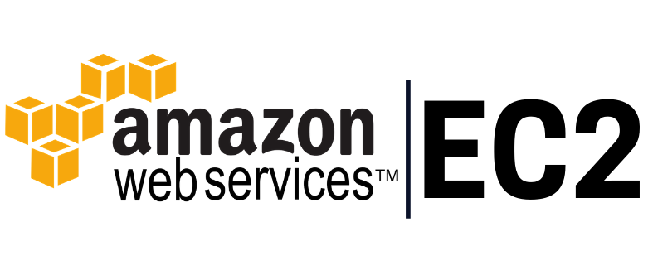
Amazon Elastic Compute Cloud (Amazon EC2) provides scalable computing capacity in the Amazon Web Services (AWS) Cloud. Using Amazon EC2 eliminates your need to invest in hardware up front, so you can develop and deploy applications faster. You can use Amazon EC2 to launch as many or as few virtual servers as you need, configure security and networking, and manage storage. Amazon EC2 enables you to scale up or down to handle changes in requirements or spikes in popularity, reducing your need to forecast traffic.

Slide 7
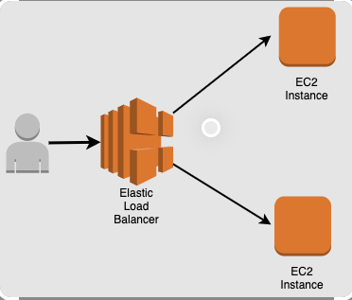
AWS Elastic Load Balancer
Elastic Load Balancing (ELB) is a load-balancing service for Amazon Web Services (AWS) deployments. ELB automatically distributes incoming application traffic and scales resources to meet traffic demands. Examples are Application Load Balancer, Network Load Balancer, and Classic Load Balancer.

Slide 8
AWS Containers (ECS and EKS)
Amazon Elastic Container Service (Amazon ECS) is a highly scalable, fast container management service that makes it easy to run, stop, and manage containers on a cluster. Your containers are defined in a task definition that you use to run individual tasks or tasks within a service.
Amazon Elastic Kubernetes Service (Amazon EKS) is a managed Kubernetes service that makes it easy for you to run Kubernetes on AWS and on-premises. Kubernetes is an open-source system for automating deployment, scaling, and management of containerized applications.

Slide 9
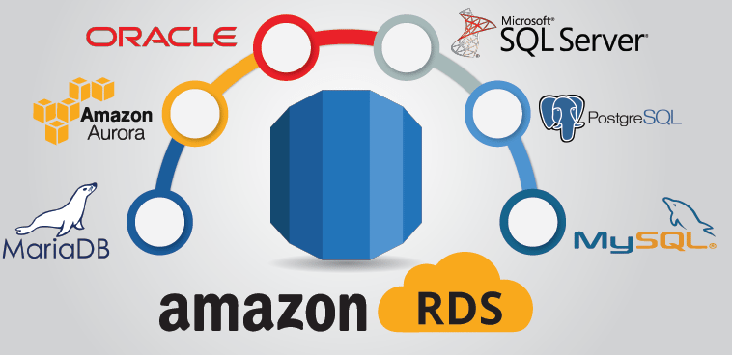
AWS Relational Database Service (RDS)
Amazon Relational Database Service (Amazon RDS) makes it easy to set up, operate, and scale a relational database in the cloud. It provides cost-efficient and resizable capacity while automating time-consuming administration tasks, such as hardware provisioning, database setup, patching, and backups. Engine examples of RDS engines are Amazon Aurora, MySQL, MariaDB, PostgreSQL, Oracle, and Microsoft SQL Server.

Slide 10
EBS, EFS, and S3
EBS
Amazon Elastic Block Store (Amazon EBS) is an easy-to-use, scalable, high-performance block-storage service designed for Amazon Elastic Compute Cloud (Amazon EC2).
EFS
Amazon Elastic File System (Amazon EFS) provides a simple, serverless, set-and-forget elastic file system for use with AWS Cloud services and on-premises resources.
S3
Amazon Simple Storage Service (Amazon S3) is an object storage service offering industry-leading scalability, data availability, security, and performance. Customers of all sizes and industries can store and protect any amount of data for virtually any use case, such as data lakes, cloud-native applications, and mobile apps. Static website hosting!

Slide 11
AWS Security Services
IAM
KMS
Secrets Manager
Parameter Store
AWS Certificate Manager
AWS WAF

Slide 12
AWS Developer(DevOps) Tools
AWS Cloud9
AWS CloudShell
AWS CodeArtifact
AWS CodeBuild
AWS CodeCommit
AWS CodeDeploy
AWS CodePipeline

